Slide 1
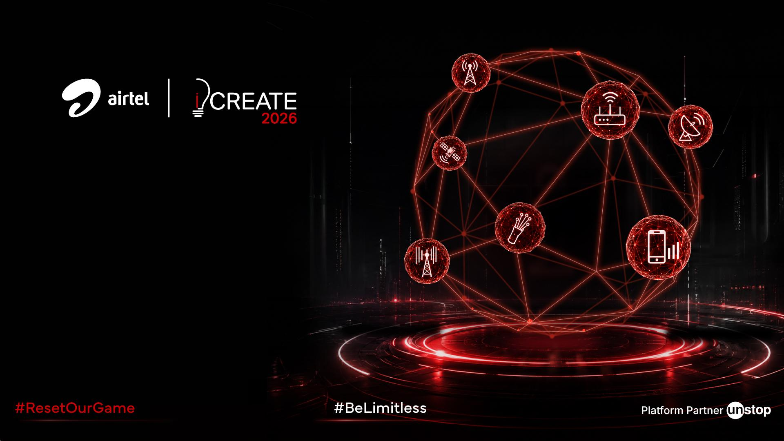
ALTURA COMMUNICATIONS
Connected Household Convergence Strategy
Maximizing Share of Wallet through Inbound Digital Platforms, Habit-Forming Bundle Pricing, Google One Storage, Autopay Incentives, and AI/ML Targeting.
Case Competition Submission | 2026 Strategy

Slide 2

Altura Communications: Strategic Diagnosis & Market Analysis
1. Wallet Opportunity & Moat
• Wallet Gaps: Connectivity accounts for 35% of household spend, but adjacent services like Entertainment (12%) and Home Security (2%) represent massive white spaces (Exhibit 3).
• Bundling Retention: Moving a customer from 1 product to 3+ services drops annual churn from 22% to 5% while increasing annual revenue from ₹5,500 to ₹18,000 (Exhibit 4).
• Postpaid Economics: Postpaid SIMs deliver ₹100 higher ARPU and 50% stronger customer stickiness than prepaid, yet organizational silos block seamless customer migrations.
2. Landscape & Persona Triggers
• Prepaid Saturation: Prepaid mobile markets are mature with high penetration and constrained pricing power. Future growth must rely on adjacencies.
• Competitive Grid: Regional broadband players are fragmented, and DTH television revenues are shrinking globally due to cord-cutting pressures (Exhibit 1 & 2).
• Persona Triggers: High-value connected households value unified billing and reward points. Core motivators include automated convenience (Autopay) and brand security trust.
3. Core Strategic Problems
• Single Point of Failure: 60%+ of households fear putting mobile and fiber under one operator due to worry over complete connectivity blackout during fiber cuts.
• Migration Complexity: Customers dread porting numbers and coordinating multiple technician visits for routers, TV boxes, and cameras.
• Product Silos: Sales and field forces work in independent silos, missing cross-sell during low-decay, in-home technician visits.

Slide 3
Altura Home: Inbound Ecosystem & AI-Enabled GTM
1. Inbound Web, AirBot Chatbot & Unified Bundling
• 4 Converged Plans: Starter (₹499/mo, 1 SIM + Xstream Play), Connect (₹999/mo, 40M Fiber + TV), Family Secure (₹999 promo, 100M Fiber + 2 SIMs + CCTV), Infinite (₹2,999/mo, 1G Fiber + 4 SIMs + 3 Cams).
• AirBot Digital Concierge: Web interactive bot using multi-select questionnaire filtering to route users to optimal bundles and reduce conversion friction.
• Autopay & Coins Incentives: Instant ₹50/mo bill discount and monthly Thanks Coins points to secure loyalty, automate renewals, and reduce admin overhead.
2. Operational Overhaul: Defeating SPOF & Installation Friction
• Independent Network Failover: Countering the 'Single Point of Failure' fear by educating users that Fiber WiFi, Cellular Postpaid SIMs, and DTH satellite feeds run on physically separate grids. Xsafe cameras failover automatically to mobile hotspots during outages.
• Single-Visit Concierge Engineers: Eliminating installation dread by deploying a single engineering specialist who installs broadband fiber, activates TV boxes, mounts CCTV cameras, and ports family mobile numbers in a single visit.
3. Outbound Target Cohorts & Field Force AI Enablement
• AI Customer Targeting: Leverage customer overlap data (Exhibit 4) to automatically run SMS & app bundle upgrade prompts for the 2.5M overlapping Broadband+DTH users and the 16M DTH-only accounts.
• Service Engineer Enablement: Equipping the field technician mobile app with a predictive recommendation engine, prompting them to pitch security cameras (Xsafe) during regular maintenance visits (capturing the 12% low decay rate).

Slide 4
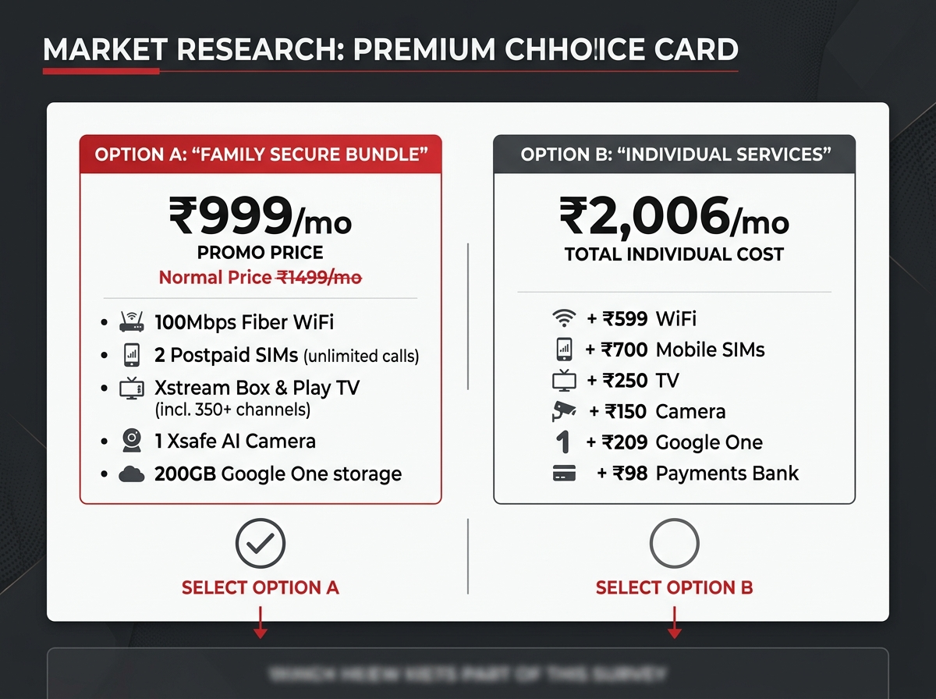
Annexure 1: Primary Research & Conjoint Choice Cards
Research Methodology & Conjoint Analysis
• Conjoint Setup: We deployed 4 binary choice questions directly comparing individual utilities vs. their bundled Altura Home counterparts (Choice Card Starter, Connect, Family Secure, and Infinite).
• Goal: This Discrete Choice Conjoint Experiment isolates exactly where price sensitivity breaks and maps household utility values.
• Quantifying SPOF: Our survey includes agree/disagree statements to map network reliability concerns and data privacy barriers.
• Uploading Cards: The generated card graphics (pictured right) help respondents visually compare price-to-benefit ratios.

Slide 5
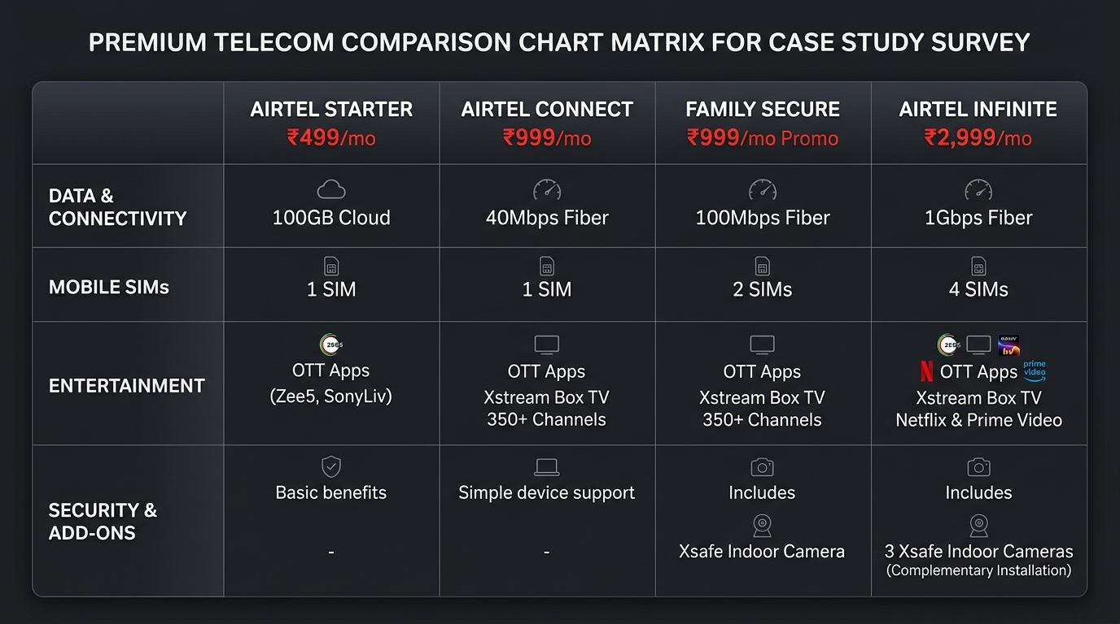
Annexure 2: Inbound Customer Portal & AirBot Interface
Digitizing the Onboarding Funnel
• Website Re-architecting: Designed a premium tab-based structure instead of long scroll sheets, streamlining categories for different household priorities.
• AirBot Integration: AirBot acts as a frictionless digital concierge. It replaces standard sales pitch dialogue with multi-select service checklists and contextual profiling.
• Autopay & Coin Loops: The online checkout dynamically demonstrates monthly savings (₹50 discount) and Thanks Coins loyalty accumulation to increase signup rates.

Slide 6
Annexure 3: Data-Driven Target Cohorts & Economics
AI-Targeted Cross-Sell Opportunities (Exhibits 4 & 5)
• Cohort A: High-Intent Overlaps (2.5M Users): Target the 2.5 million households subscribing to both Broadband and DTH. Since they are already double-billed, they represent low-hanging fruit for the 'Connect' or 'Family Secure' bundles.
• Cohort B: DTH-Only Accounts (16M Users): DTH is expected to decline due to streaming (Exhibit 2). Transitioning these 16 million siloed accounts into converged Fiber+SIM+TV bundles saves them money while preventing DTH cord-cutting.
• Channel Optimization: Digital channel CAC is 50% lower than direct sales (Broadband: ₹220 vs ₹450), but direct sales secure higher Month-4 retention. We route online AirBot leads directly to concierge field technicians to optimize conversion.

Slide 7
Annexure 4: Bundle Pricing Model & EBITDA Accretion
Converged Pricing Sheets & EBITDA Margins (Exhibits 1 & 2)
• Individual vs. Bundle Price Matrix:
- Standalone Sum: Broadband (₹599) + 2 SIMs (₹700) + Xstream Box (₹250) + Google One (₹209) + Xsafe CCTV (₹150) + Bank (₹99) = ₹2,006/mo.
- Consolidated Family Secure: ₹1,499/mo (Saves ₹507/mo or 25% discount). Promoted at ₹999/mo for the first 3 months to destroy switching inertia.
• Margin Protection: Home Surveillance holds the highest EBITDA margin at 35% (Exhibit 1) and is growing at 35.7% CAGR (Exhibit 2). By bundling Xsafe cameras into Family Secure and Infinite tiers, we offset lower TV margins (12% EBITDA) and drive net margin expansion.
• Retention Leverage: Reducing household churn from 22% down to 5% lifts customer lifetime value (LTV) by over 400%, easily amortizing the initial ₹999/mo introductory launch promo cost.

Slide 8
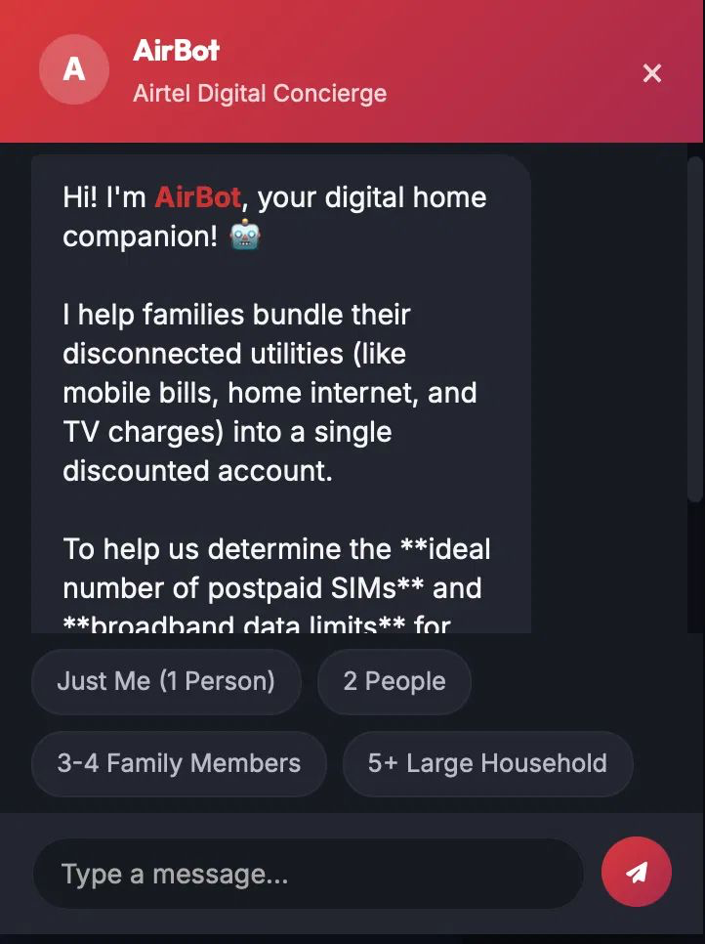
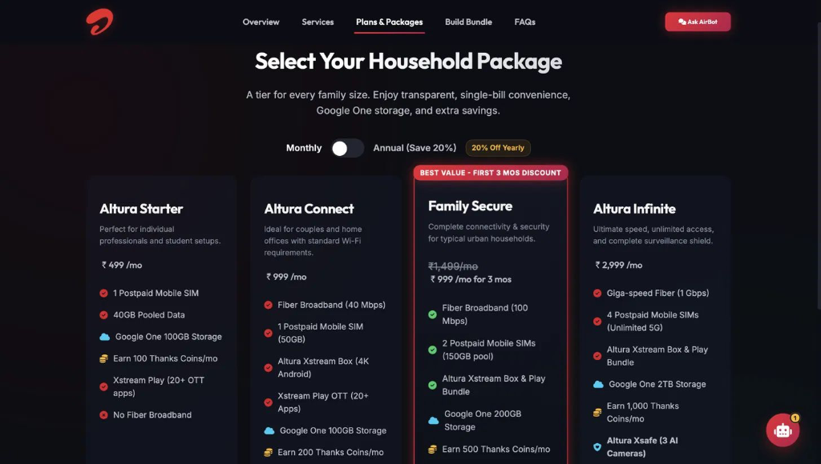
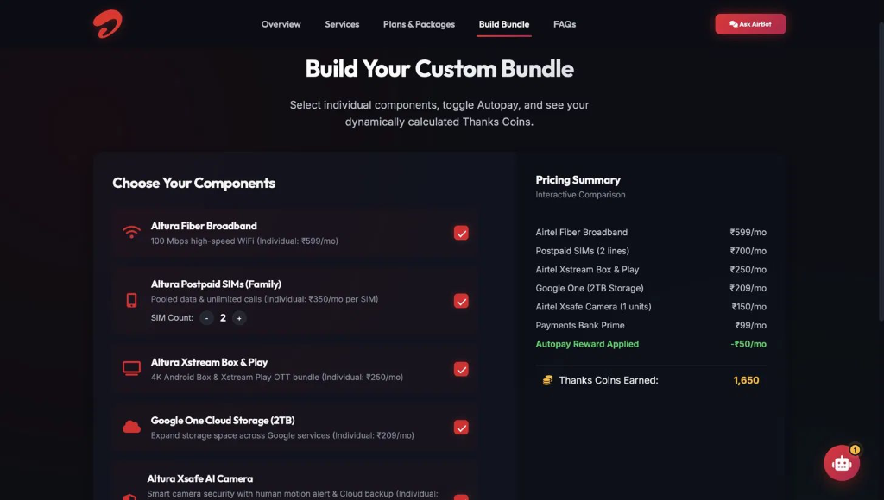
Altura Home: Inbound GTM Strategy & Onboarding Platform
1. Inbound Strategy & Pricing Psychology
• Inbound Focus: Prioritize converting our existing 20 million active relationships (siloed accounts) to double wallet share, rather than high-CAC outbound acquisition.
• 4 Bundle Portfolio: Altura Starter (₹499/mo), Altura Connect (₹999/mo), Family Secure (₹1,499/mo), and Altura Infinite (₹2,999/mo).
• Bundle Psychology & Habit Loop: We discounted the Family Secure bundle to ₹999/mo for the first 3 months, equating it to the price of the basic Connect bundle. Users choose the higher-tier plan due to price-equivalence. During the 3-month trial, they develop a habit around 100 Mbps fiber, smart TV, and Xsafe cameras. Post-trial, they continue at the ₹1,499/mo standard rate, lifting ARPU.
• Outbound Note: Direct sales can utilize targeted SMS/App push to overlaps, but the core engine is inbound portal conversion.
AirBot AI Concierge
Our integrated AI assistant dynamically profiles household sizes and service priorities using multi-select checklist filters, routing users to optimal packages and reducing funnel drop-off.
Transparent Plans & Packages
Showcases pre-calculated tiers with clear highlight cards on the Family Secure ₹999/mo promo to trigger the price-equivalence purchase loop.
Build Your Custom Bundle
Replaces rigid plans. Users pick only what they use (Fiber speed, SIM count, Cameras) and calculate dynamic costs, eliminating the utility waste of unused services.

Slide 9
Annexure 1: Primary Research & Conjoint Choice Cards
Research Methodology & Conjoint Analysis
• Conjoint Setup: We deployed 4 binary choice questions directly comparing individual utilities vs. their bundled Altura Home counterparts (Choice Card Starter, Connect, Family Secure, and Infinite).
• Goal: This Discrete Choice Conjoint Experiment isolates exactly where price sensitivity breaks and maps household utility values.
• Quantifying SPOF: Our survey includes agree/disagree statements to map network reliability concerns and data privacy barriers.
• Uploading Cards: The generated card graphics (pictured right) help respondents visually compare price-to-benefit ratios.

Slide 10
Annexure 2: Inbound Customer Portal & Choice Matrices
Digitizing the Onboarding Funnel
• Website Re-architecting: Designed a premium tab-based structure instead of long scroll sheets, streamlining categories for different household priorities.
• AirBot Integration: AirBot acts as a frictionless digital concierge. It replaces standard sales pitch dialogue with multi-select service checklists and contextual profiling.
• Autopay & Coin Loops: The online checkout dynamically demonstrates monthly savings (₹50 discount) and Thanks Coins loyalty accumulation to increase signup rates.

Slide 11
Annexure 3: Data-Driven Target Cohorts & Economics
AI-Targeted Cross-Sell Opportunities (Exhibits 4 & 5)
• Cohort A: High-Intent Overlaps (2.5M Users): Target the 2.5 million households subscribing to both Broadband and DTH. Since they are already double-billed, they represent low-hanging fruit for the 'Connect' or 'Family Secure' bundles.
• Cohort B: DTH-Only Accounts (16M Users): DTH is expected to decline due to streaming (Exhibit 2). Transitioning these 16 million siloed accounts into converged Fiber+SIM+TV bundles saves them money while preventing DTH cord-cutting.
• Channel Optimization: Digital channel CAC is 50% lower than direct sales (Broadband: ₹220 vs ₹450), but direct sales secure higher Month-4 retention. We route online AirBot leads directly to concierge field technicians to optimize conversion.

Slide 12
Annexure 4: Bundle Pricing Model & EBITDA Accretion
Converged Pricing Sheets & EBITDA Margins (Exhibits 1 & 2)
• Individual vs. Bundle Price Matrix:
- Standalone Sum: Broadband (₹599) + 2 SIMs (₹700) + Xstream Box (₹250) + Google One (₹209) + Xsafe CCTV (₹150) + Bank (₹99) = ₹2,006/mo.
- Consolidated Family Secure: ₹1,499/mo (Saves ₹507/mo or 25% discount). Promoted at ₹999/mo for the first 3 months to destroy switching inertia.
• Margin Protection: Home Surveillance holds the highest EBITDA margin at 35% (Exhibit 1) and is growing at 35.7% CAGR (Exhibit 2). By bundling Xsafe cameras into Family Secure and Infinite tiers, we offset lower TV margins (12% EBITDA) and drive net margin expansion.
• Churn Leverage: Reducing household churn from 22% down to 5% lifts customer lifetime value (LTV) by over 400%, easily amortizing the initial ₹999/mo introductory launch promo cost.

